Slide 1

ASTRO 6523: Modeling, Mining and Machine Learning in Astronomy
Classification of Stars, Galaxies and Quasars using Photometric and Spectroscopic measurements from the Sloan Digital Sky Survey (SDSS)
Rafid Bendimerad
PhD Candidate – Mechanical and Aerospace Engineering – Cornell University
May 11, 2023

Slide 2
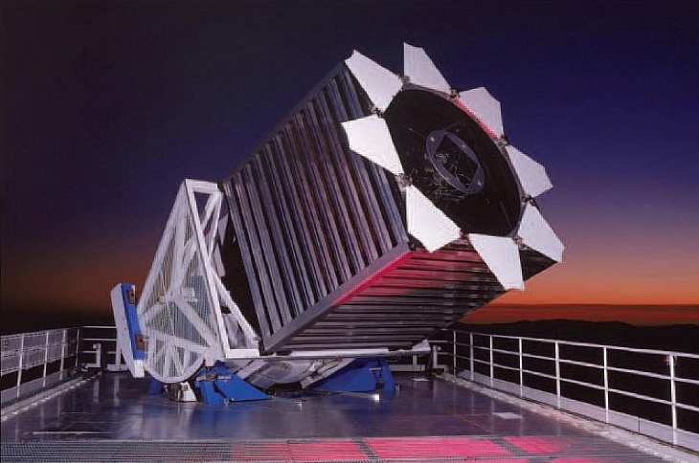
1- Introduction
Sloan Digital Sky Survey (SDSS) is a multi-spectral imaging and spectroscopic redshift survey.
It uses a 2.5-m wide-angle optical telescope at Apache Point Observatory (APO) in south-east New Mexico, USA.
Started in the year 2000 and is still operating.
Has led to many scientific discoveries, such us the production of high-precision maps of cosmic expansion history and the discovery of new celestial objects like brown dwarfs and distant quasars.
image credit: SDSS

Slide 3
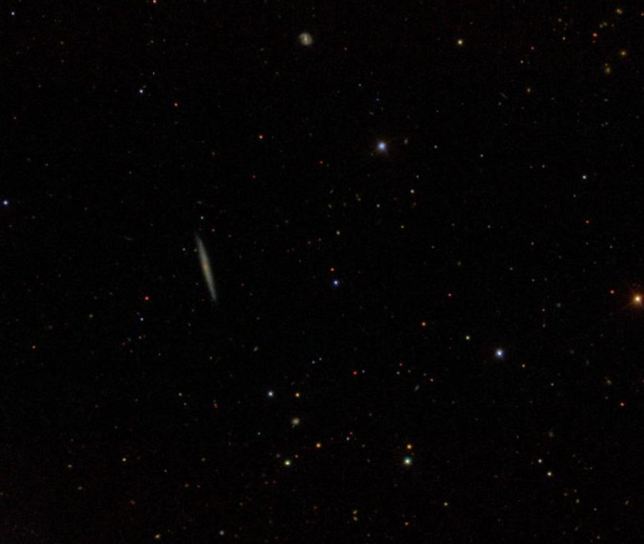
1- Introduction
Image taken from SDSS online navigation tool.

Slide 4
1- Introduction
Galaxy
Star
Quasar
Image taken from SDSS online navigation tool.

Slide 5
1- Introduction
Quasar: short for "quasi-stellar radio source”.
It is an extremely luminous active galactic nucleus.
Located billions of light years away.
Important role in Cosmology: Quasars serve as important beacons in cosmology. They help in mapping the distribution of galaxies in the universe and provide insights into the early universe conditions.
Galaxy
Star
Quasar
Image taken from SDSS online navigation tool.

Slide 6
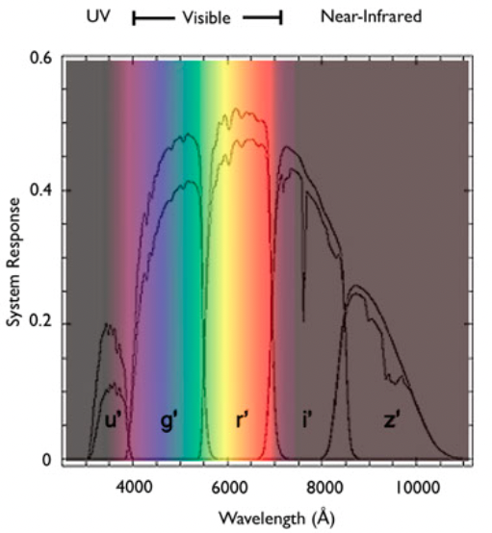
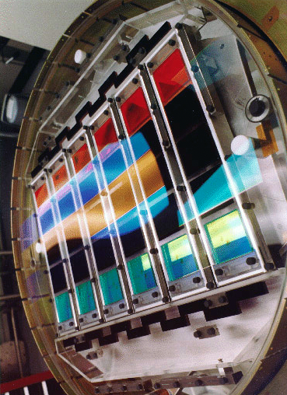
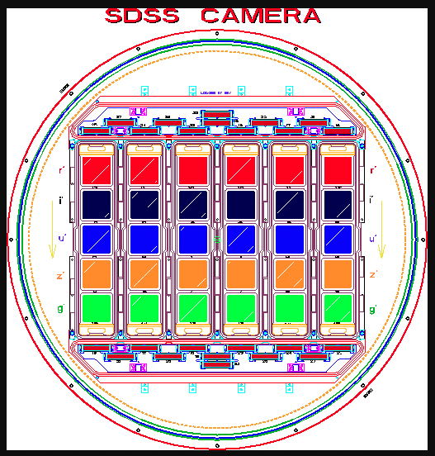
2- Understanding the data
Band | Centered on
u’ | 354 nm | Ultraviolet
g’ | 475 nm | Green
r‘ | 622 nm | Red
i‘ | 763 nm | Near infrared
z‘ | 905 nm | infrared
images credit: SDSS

Slide 7
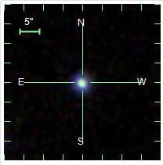
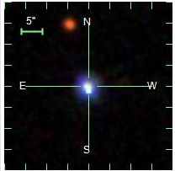
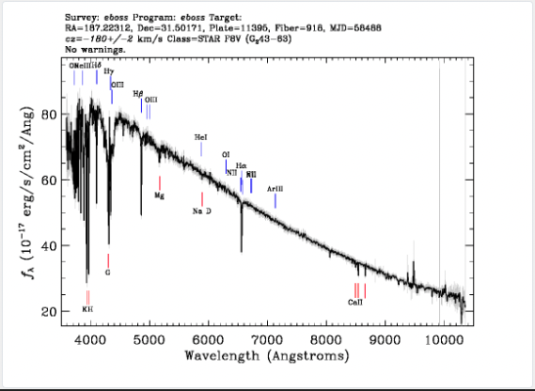
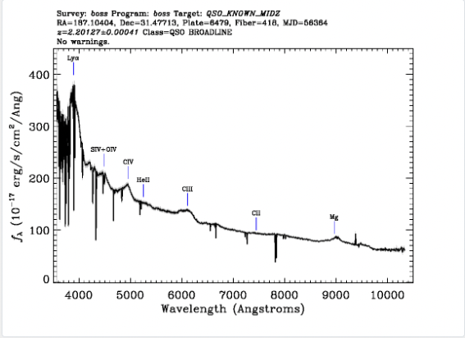
2- Understanding the data
Star
Quasar

Slide 8
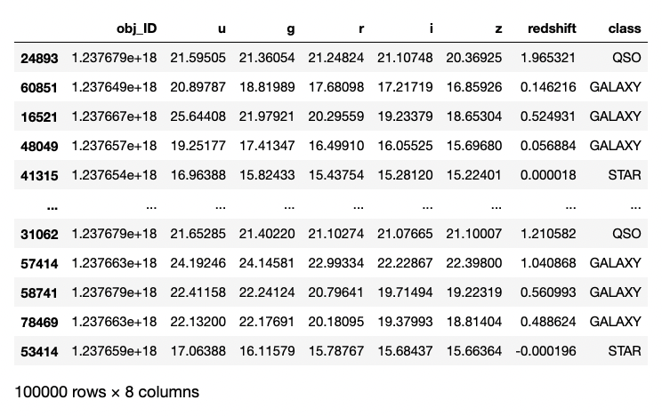
2- Understanding the data

Slide 9
2- Understanding the data

Slide 10
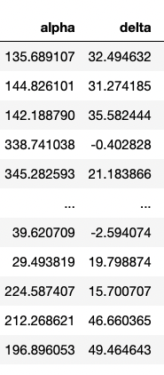
2- Understanding the data
Right ascension
Declination

Slide 11
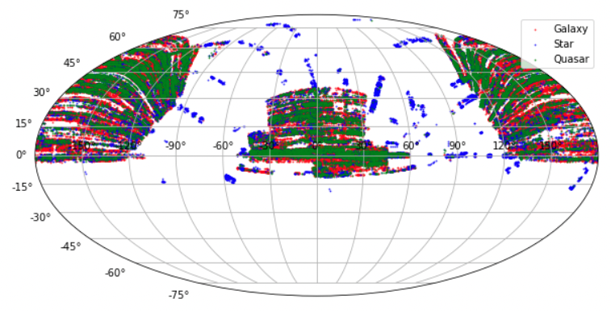
2- Understanding the data
Celestial coordinates of the sample

Slide 12
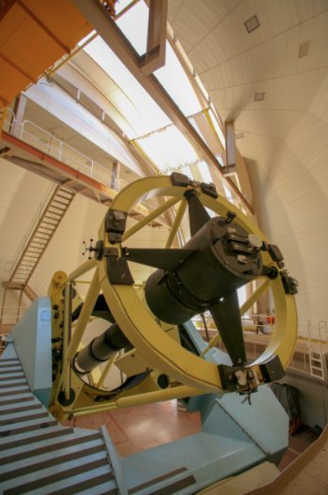
2- Understanding the data
Celestial coordinates of the sample
Use a second telescope in the opposite side of the planet
du Pont Telescope since 2017, Chile
image credit: Carnegie institution for science

Slide 13
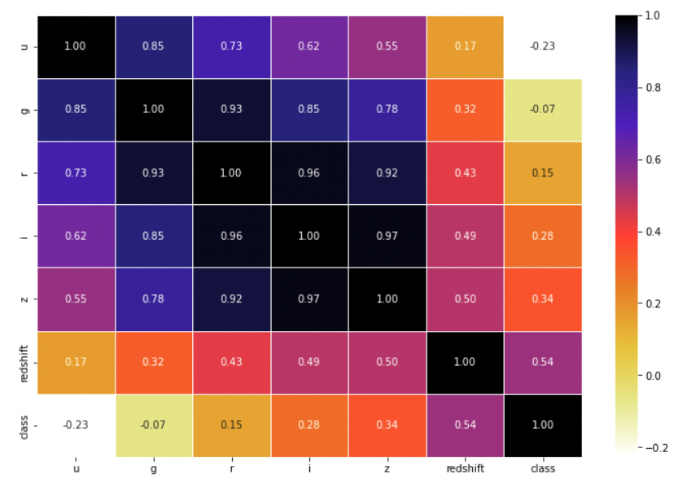
3- Preprocessing the data
Feature Selection
u
g
r
i
59,445
59,445
59,445
z
Redshift
Class
u
g
r
i
z
Redshift
Class

Slide 14
3- Preprocessing the data
Feature Selection
u
Threshold=0.95
g
r
i
59,445
59,445
59,445
z
Redshift
Class
u
g
r
i
z
Redshift
Class

Slide 15

3- Preprocessing the data
Feature Selection
u
Threshold=0.95
g
r
i
Get rid of: (i) near infrared filter
(z) infrared filter
59,445
59,445
59,445
z
Redshift
Class
u
g
r
i
z
Redshift
Class

Slide 16
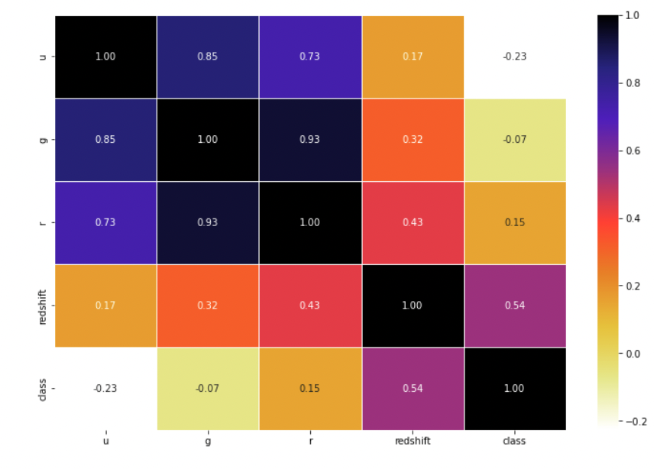
3- Preprocessing the data
Feature Selection
u
g
r
Redshift
Class
u
g
r
Redshift
Class

Slide 17
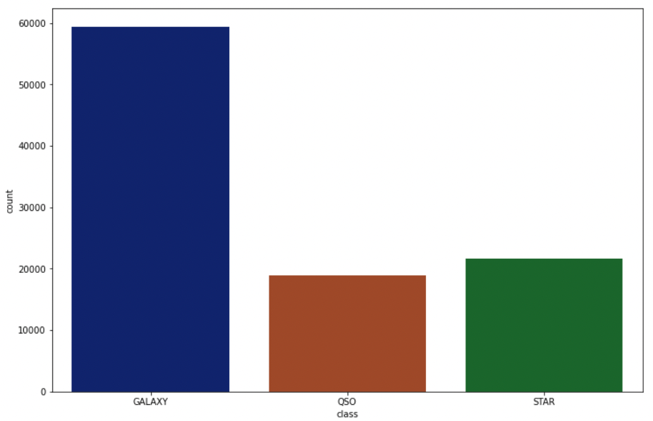
3- Preprocessing the data
Unbalanced Data
Count
59,445
18,961
21,594
Galaxy
Quasar
Star

Slide 18
3- Preprocessing the data
SMOTE : Synthetic Minority Oversampling Technique
Majority class
Minority class

Slide 19
3- Preprocessing the data
SMOTE : Synthetic Minority Oversampling Technique
Majority class
Minority class

Slide 20
3- Preprocessing the data
SMOTE : Synthetic Minority Oversampling Technique
Real data point
Synthetic data point
Majority class
Minority class

Slide 21
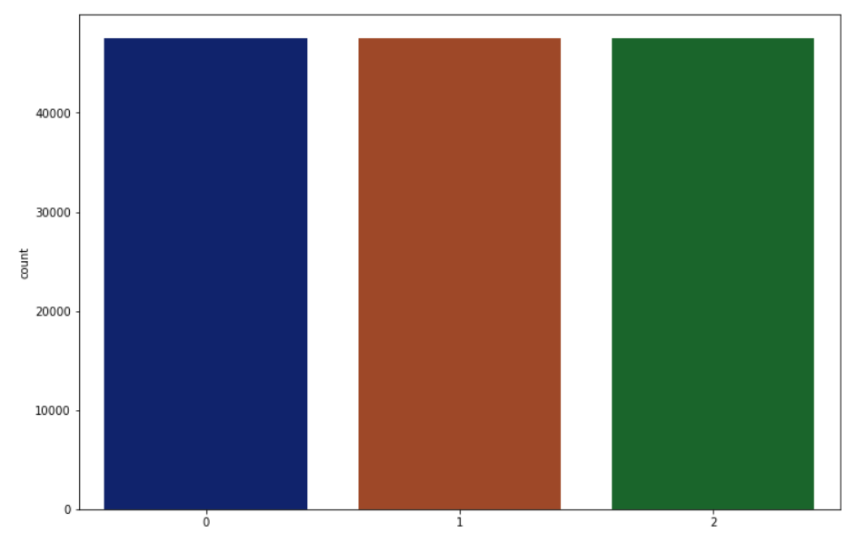
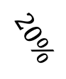
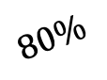
3- Preprocessing the data
SMOTE : Synthetic Minority Oversampling Technique
Scaled data set
Training set
…………
…………
…………
…………
…………
…………
…………
…………
…………
…………
…………
…………
…………
…………
…………
…………
…………
…………
SMOTE
$$80\%$$
Count
47,556
47,556
47,556
$$20\%$$
…………
…………
Test set
Galaxy
Quasar
Star

Slide 22
3- Preprocessing the data
SMOTE : Synthetic Minority Oversampling Technique
-1
0
+1
SMOTE caused a slight change in the mean and the std

Slide 23
3- Preprocessing the data
SMOTE : Synthetic Minority Oversampling Technique
-1
0
+1
SMOTE caused a slight change in the mean and the std
Scaling
SMOTE
Scaling

Slide 24
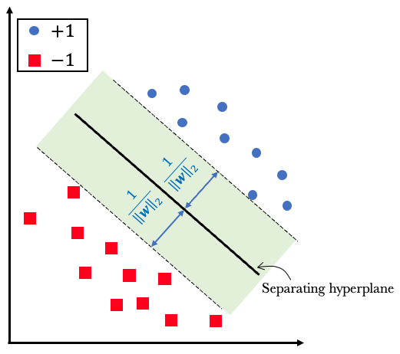
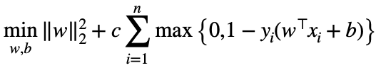
4- Classification
a/ Support Vector Machine

Slide 25
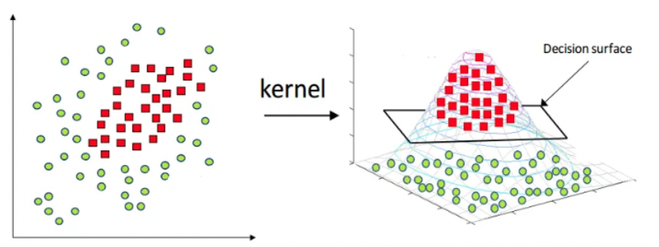
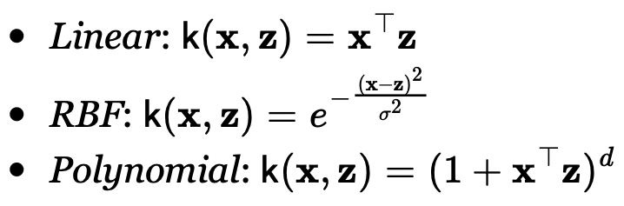
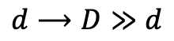
4- Classification
a/ Support Vector Machine
$$d⟶D≫d$$
Not linearly separable
Linearly separable
image credit: www.analyticsvidhya.com

Slide 26
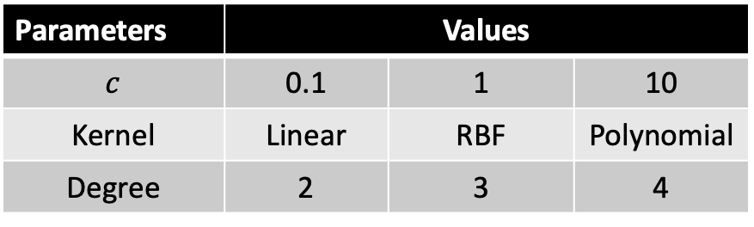
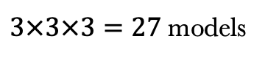
4- Classification
a/ Support Vector Machine
$$d⟶D≫d$$
Not linearly separable
Linearly separable
Grid Search
$3×3×3=27$models
Parameters | Values
$c$ | 0.1 | 1 | 10
Kernel | Linear | RBF | Polynomial
Degree | 2 | 3 | 4
image credit: www.analyticsvidhya.com

Slide 27
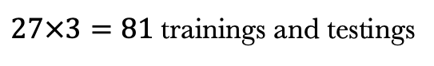
4- Classification
a/ Support Vector Machine
3-Fold Cross Validation
Fold 1
Fold 2
Fold 3
Grid Search
$3×3×3=27$models
Model 1
Parameters | Values
$c$ | 0.1 | 1 | 10
Kernel | Linear | RBF | Polynomial
Degree | 2 | 3 | 4
Model 2
Model 3
$27×3=81$trainings and testings
Final Model
Mean
Training set
Validation set

Slide 28
4- Classification
a/ Support Vector Machine
3-Fold Cross Validation
Fold 1
Fold 2
Fold 3
Grid Search
$3×3×3=27$models
Model 1
Parameters | Values
$c$ | 0.1 | 1 | 10
Kernel | Linear | RBF | Polynomial
Degree | 2 | 3 | 4
Model 2
Model 3
$27×3=81$trainings and testings
Final Model
Mean
Training time: 3h : 30min
Training set
Best model: {c = 10, degree = 2, kernel= 'rbf’}.
Train it again on the whole training set. Test Accuracy: 0.94
Validation set

Slide 29
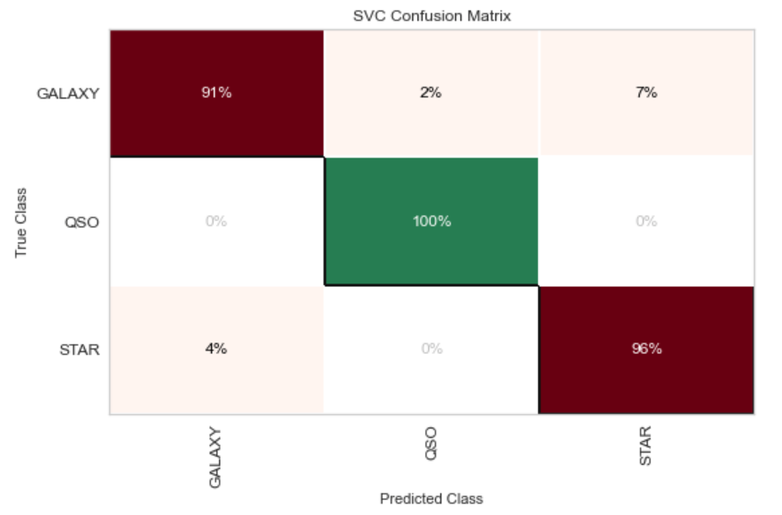
4- Classification
Confusion Matrix

Slide 30
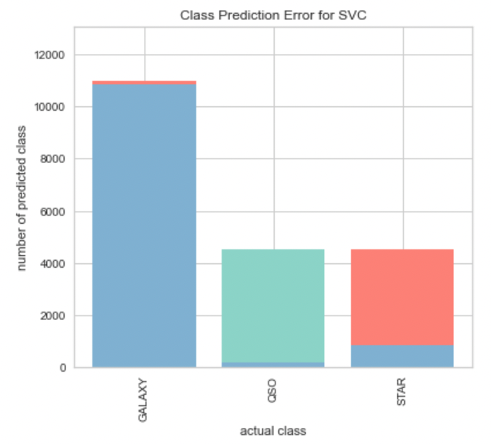
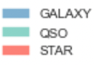
4- Classification
Confusion Matrix

Slide 31
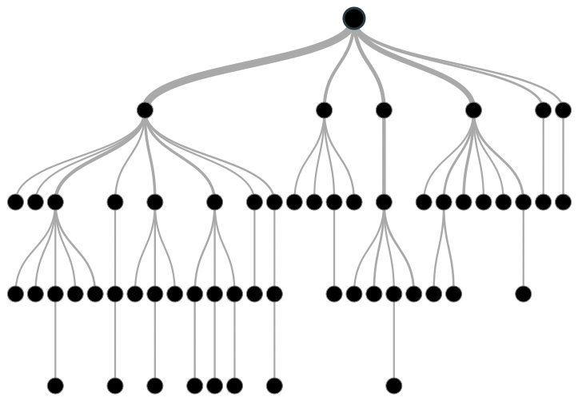
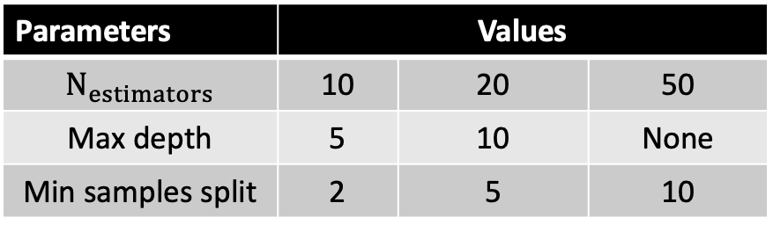
4- Classification
b/ Random Forest
Grid Search
$3×3×3=27$models
Parameters | Values
$N_{estimators}$ | 10 | 20 | 50
Max depth | 5 | 10 | None
Min samples split | 2 | 5 | 10
image courtesy: https://wiki.pathmind.com/decision-tree

Slide 32
4- Classification
b/ Random Forest
3-Fold Cross Validation
Fold 1
Fold 2
Fold 3
Grid Search
$3×3×3=27$models
Model 1
Parameters | Values
$N_{estimators}$ | 10 | 20 | 50
Max depth | 5 | 10 | None
Min samples split | 2 | 5 | 10
Model 2
Model 3
$27×3=81$trainings and testings
Final Model
Mean
Training set
Validation set

Slide 33
4- Classification
b/ Random Forest
3-Fold Cross Validation
Fold 1
Fold 2
Fold 3
Grid Search
$3×3×3=27$models
Model 1
Parameters | Values
$N_{estimators}$ | 10 | 20 | 50
Max depth | 5 | 10 | None
Min samples split | 2 | 5 | 10
Model 2
Model 3
$27×3=81$trainings and testings
Final Model
Mean
Training time: 4 min
Best model: {'max_depth': None, 'min_samples_split': 2, 'n_estimators': 50}
Train it again on the whole training set.
Test Accuracy: 0.823 < 0.940
Training set
Validation set

Slide 34
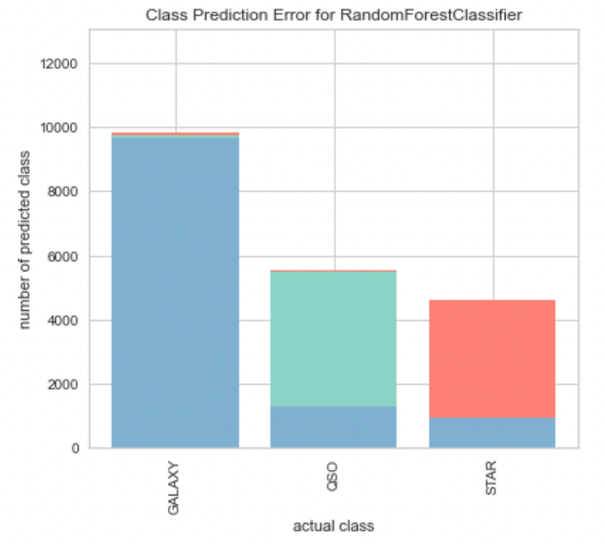
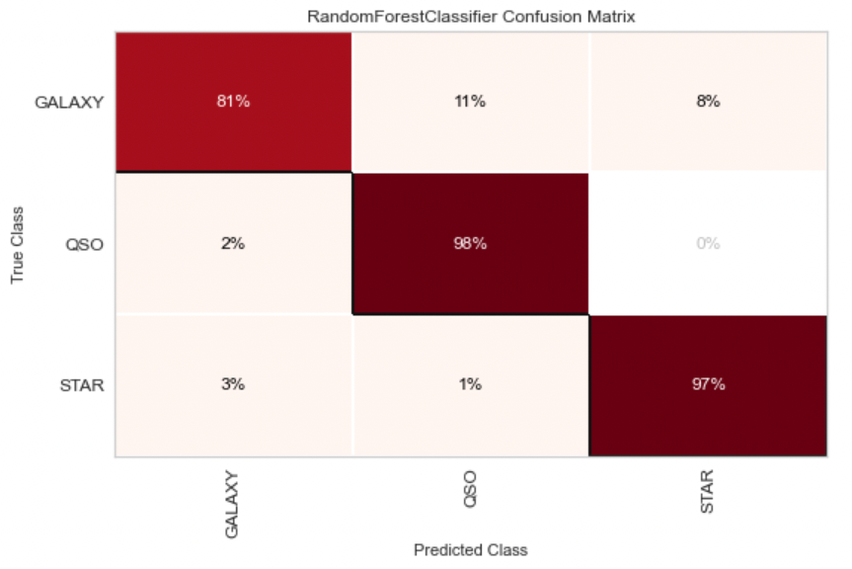
4- Classification
Confusion Matrix

Slide 35
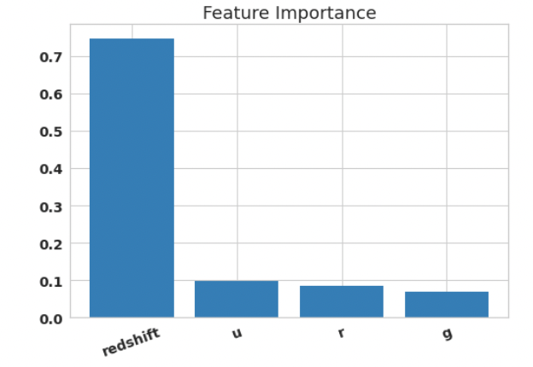
4- Classification
Importance plot

Slide 36
4- Classification
Importance plot
Recall:
Star
Quasar

Slide 37
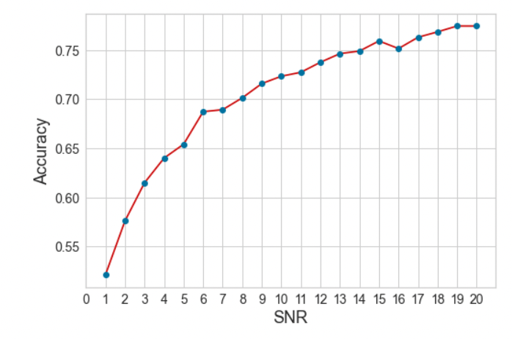
4- Classification
Test the Sensitivity of the RF to Noise

Slide 38
5- Conclusions
Algorithm | Computation time | Test Accuracy
SVM | 3h:30min | 0.940
Random Forest | 4 min | 0.823
The SVM is about 50 times slower but 12% more accurate than the RF.
We could potentially increase the number of estimators (i.e.: number of trees) in the RF to see if we can increase the accuracy while preserving the speed.
The redshift is the most important feature to classify the data set.
The influence of the noise on the accuracy of the RF becomes negligible at about SNR=15.

Slide 39
Thank You !
Any Questions ?

